Slide 1
Course 227 Lab 3 – Waveguide Structures CST Microwave Studio
Dr Harry Marks
h.marks@lancaster.ac.uk

Slide 2
Objectives:
Become more familiar with CST Microwave Studio by simulating new structures:
Simulate a 3-port structure with two matched, and one unmatched port.
Simulate a magic-tee waveguide coupler.

Slide 3
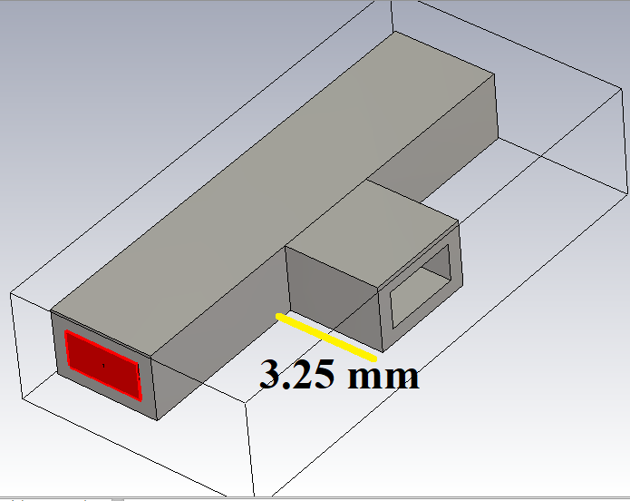
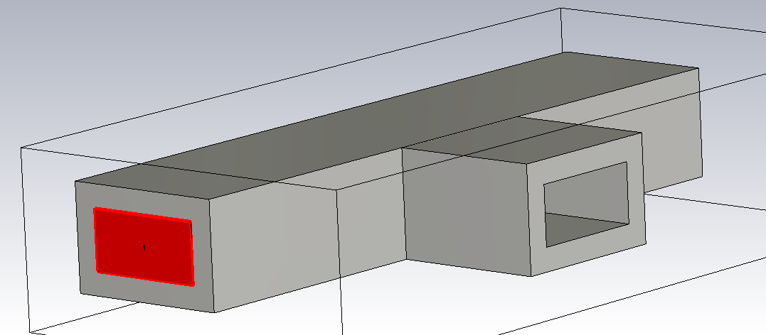
Using what you learned in lab 2, create the three port structure shown above.
Like in lab 2 the dimensions of the waveguide should be WR10, that is, inner dimensions 2.54 mm by 1.27 mm.
The material is PEC, perfect electric conductor.
If your structure doesn’t look grey like the above picture you may have selected the wrong material.
The length of the waveguide coming out the side of the main waveguide section should be 3.25 mm.

Slide 4
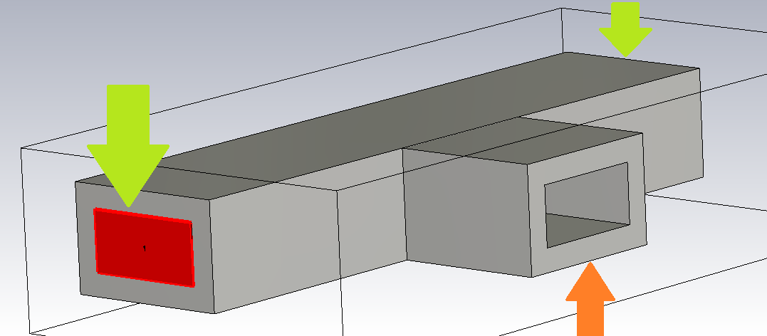
As you learned in lab 2, generate ports where the green arrows are shown.
Do not generate a port where the orange arrow is shown.
If you have already generated a port here you can delete the port using the menu on the left hand side.
When a port is generated in CST it is a matched load, it is as if the waveguide continued forever from this point. In other words, there are no reflections. Not defining a port where the orange arrow is shown means we will have reflections from this point.
Run a simulation from 80 to 125 GHz.
Save the 1D, S11 and S21 data.
Include this in your final report.

Slide 5
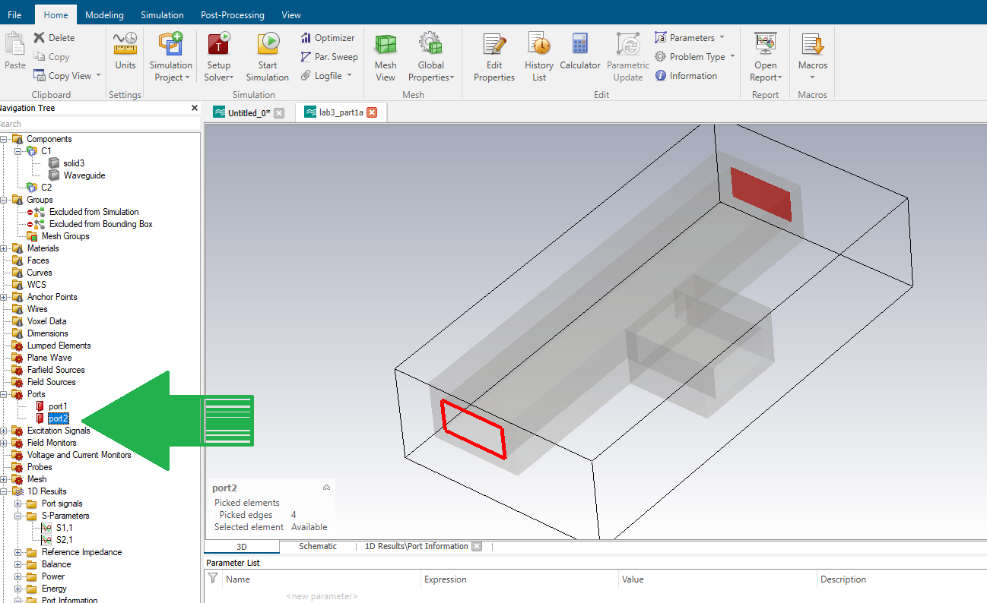
If you put in a port where the orange arrow was shown on the previous slide you can delete it by clicking where the green arrow is showing and pressing delete.

Slide 6
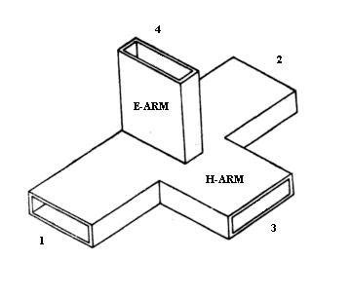
Generate the device shown above using the inner waveguide dimensions we have used so far, that is, 2.54 mm by 1.27 mm
Create ports at each junction.
Collect the 1D S-parameter data for each port and include it in your final report.
Comment on what you find.

Slide 7
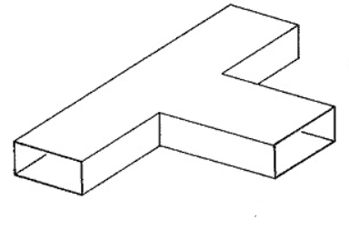
Objectives for the Final Report: Part 3
Build the simulations described on the previous slides.
Include in your report:
1D plots of all the scattering parameters.
For the first simulation this is just S11, S12, S22, S21
For the 2nd simulation include the data from each of the four ports.
Where appropriate plots these on the same graphs.
Include 3-D plots in different planes (XY, XZ, YZ).
These results will go into Part 3 of the report

